Slide 1



A Clinical Decision Support System -Paediatric Life Support
Presented by Sebastian Fernandez, Magdalena Hardegger, Albertine Karsies & Prerna Duhan

Slide 2


Overview
01
Vision
02
Personas & Scenarios
03
Operational L2
04
Machine Readable L3 &
Executable L4

Slide 3



Vision
Managing critical illness
in infants & children:
highly complex
distinct pathophysiological processes
Support healthcare providers
timely and effective interventions
reducing cognitive load
Focus on PALS
System should:
Assist in the decision-making process for the shockable and non-shockable heart rhythms
as well as manage chest compressions, drug doses, and shock dosages.

Slide 4


European Resuscitation Council Guideline: Paedriatric Advanced Life Support
The European Resuscitation Council Guidelines 2021: Paediatric Life Support provides a comprehensive framework for managing critically ill or injured children.
The main objectives and key points are structured on the main chapters Recognition and Management of Critically Children, PBLS (Basic Life Support), PALS (Advanced Life Support), Oxygenation and Ventilation, Post-Resuscitation Care.
PALS is a team-based approach where multiple interventions often occur simultaneously.
Notes:
Why did we select this

Slide 5

Operational: Layer 2
Component 1 | Health interventions and recommendations
Component 2 | Generic Personas
Component 3 | User Scenarios
Component 4 | Generic business process and workflows
Component 5 | Core data elements
Component 6 | Decision support logic
Component 7 | Indicators and performance metrics
Component 8 | Functional and non-functional requirements

Slide 6
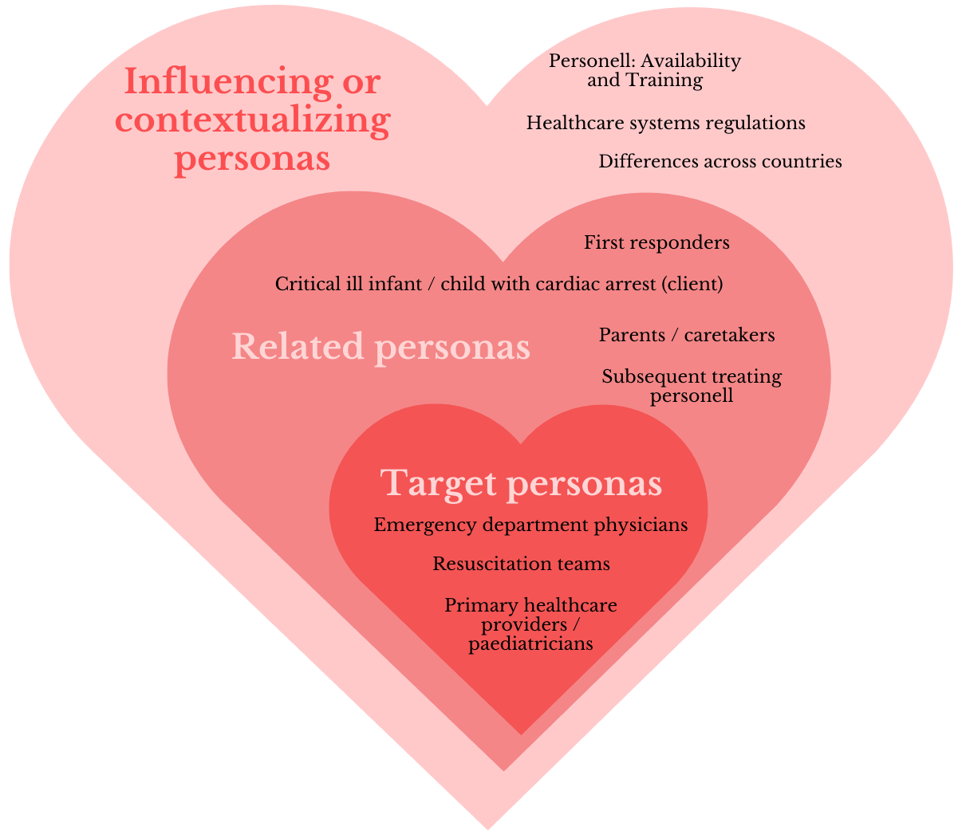
User Personas
The targeted personas for this PALS CDSS are resuscitation teams, primary healthcare providers/paediatrics and emergency department physicians.
Related personas involved are PALS trained emergency paramedics and nursing staff.
Additional personas involved are the critically ill infant/child with cardiac arrest (client), the first responders, the parents/caretakers of the client, and further treating personnel.
Influence of Contextualizing personas: There may be differences in certain countries and health systems including regulations of healthcare personnel.

Slide 7








User Scenarios
User Scenario 1
Transport to ER
Paedriatric cardiac arrest in the emergency room
Ben
Sam
Thomas
At ER
Sets up bag-mask ventilation
Patient: Sam
Family, father: Ben
Team Leader: Dr. Katy, Paediatric Emergency Physician
Nurse: Cynthia, Paediatric Nurse
Respiratory Therapist: Jack
Paramedic: Thomas
Jack
Dr. Katy
Cynthia
Compressions
Administers 200 mcg adrenaline
Uses the CDSS
Enters weight
Assess the rhythm
Continue CPR
Request vascular access
Notes:
[Ben discovers Sam unresponsive]
↓
[Ben initiates BLS]
↓
[Thomas (Paramedic) arrives]
↓
[Transport to ER with BLS]
↓
[Dr. Katy (Team Leader) takes charge]
↓
│ │
│ [Cynthia] │
│ [Begins chest compressions] │
│ │
│ [Jack] │
│ [Sets up bag-mask ventilation] │
│ │
│ [Thomas] │
│ [Applies defibrillator pads, connects monitor] │
[Dr. Katy uses digital assist system]
[Enters estimated weight: 20 kg]
↓
[System prompts Dr. Katy to assess rhythm]
↓
[Cardiac Monitor shows PEA]
↓
[System displays PEA management checklist, prompts CPR]
↓
[Dr. Katy instructs team to continue high-quality CPR, assesses]
↓
[Cynthia continues compressions, no pulse check]
↓
[Dr. Katy requests vascular access (IV/IO)]
↓
[System suggests difficult IV access options]
↓
[Thomas establishes IO access]
↓
[Cynthia administers 200 mcg adrenaline]
[Flushes with saline, as per system]
↓
[System sets timer for 2-minute reassessment]
↓
[Cardiac Monitor reassessment: still PEA]
↓
[System prompts: continue CPR, prepare next adrenaline dose]

Slide 8



User Scenarios
IN PICU
User Scenario 2
Uses CDSS
Enters Maya’s weight
Paedriatric ventricular fibrillation in a paedriatric intensive care unit
Lea
Dr. Patrick
Starts chest compressions
Maya
Patient: Maya
PICA Attending: Dr. Patrick
PICU Nurse: Lea
PICU Fellow: Dr. Astrid
Respiratory Therapist: Mick
Prepares defibrillator, attaches pads
Charges defribillator
Delivers shock
Dr. Astrid
Ventilates with bag-mask
Mick
Notes:
[Maya in PICU post-surgery]
↓
[Bedside Monitor alarms: VF]
↓
[Lea starts chest compressions, calls for help]
↓
[Dr. Patrick, Dr. Astrid, Mick arrive at bedside]
↓
┌────────────────────────────────────────────────────┐
│ │
│ [Mick] │
│ [Ventilates with bag-mask, 100% oxygen] │
│ │
│ [Dr. Astrid] │
│ [Prepares defibrillator, attaches pads] │
└────────────────────────────────────────────────────┘
↓
[Dr. Patrick uses digital assist system]
[Follows PALS protocol for VF]
[Enters Maya’s weight: 26 kg]
↓
[System prompts: Charge defibrillator to 104 J]
[Ensure all rescuers are clear before shock]
↓
[Dr. Astrid charges defibrillator, counts down]
[Compressions paused for shock]
↓
[Dr. Astrid delivers shock]
[System prompts: Resume CPR]
↓
[After 2 minutes: reassess rhythm]
↓
[Rhythm: Persistent VF]
[System advises: Administer medications]
[260 mcg adrenaline (10 mcg/kg)]
[130 mg amiodarone (5 mg/kg)]
[Followed by saline flush]
↓
[Team prepares for shock]
↓
[After third shock: rhythm changes]
[Organized rhythm]
[ROSC indicated by improved etCO2 and spontaneous breathing]
↓
[Digital assist system: Post-ROSC care guidelines]
[Titrate oxygen to maintain SpO2 94-98%]
[Closely monitor Maya’s vital signs]

Slide 9
Operational: Layer 2
Component 1 | Health interventions and recommendations
Component 2 | Generic Personas
Component 3 | User Scenarios
Component 4 | Generic business process and workflows
Component 5 | Core data elements
Component 6 | Decision support logic
Component 7 | Indicators and performance metrics
Component 8 | Functional and non-functional requirements

Slide 10

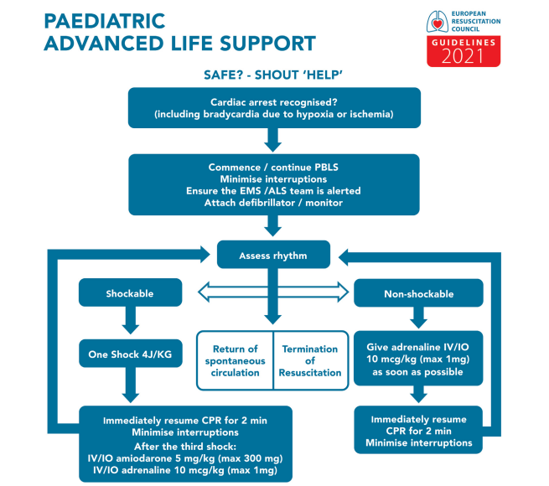
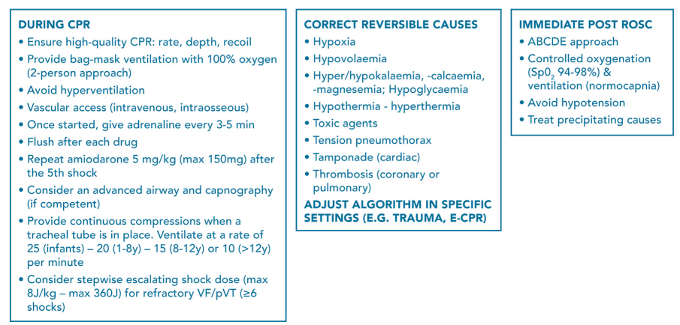
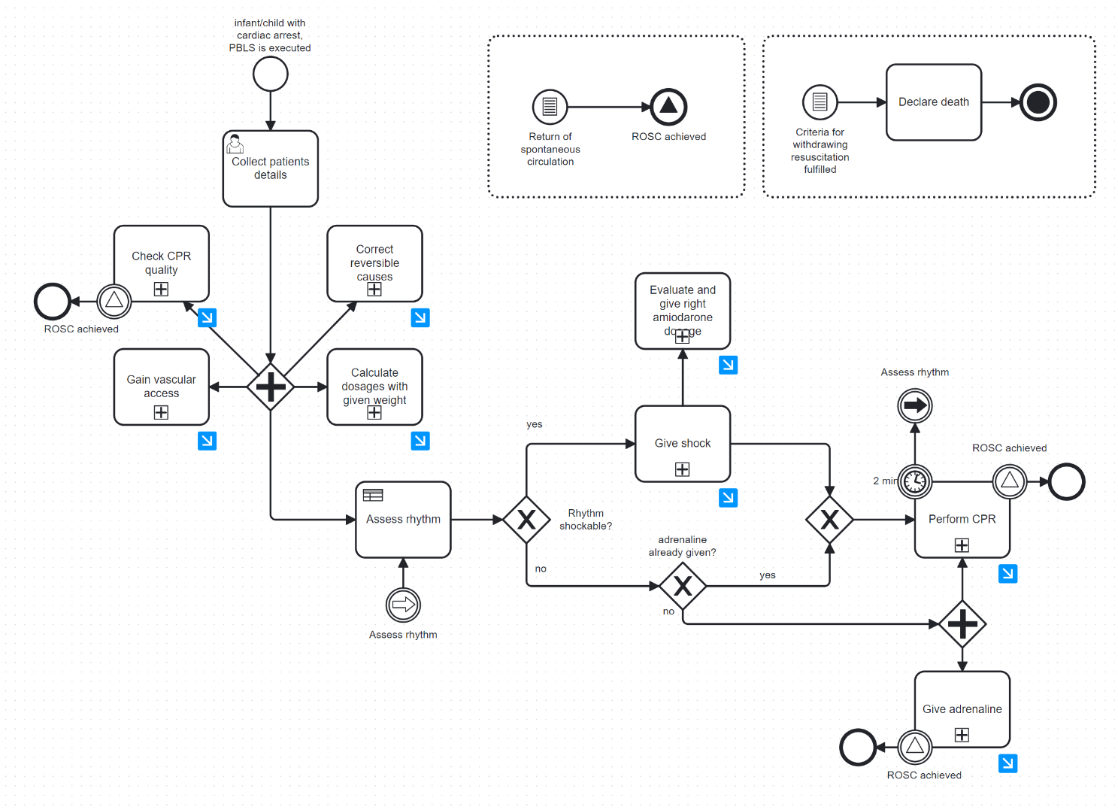

High Level Workflow
Transition from guideline to machine readable format
L1 --> L2
As PALS is executed by a team, orchestrated by a team-leader, there are several sub-processes and loops taking place in parallel.
The Workflows are structured using standardized notations for business process models (BPMN)

Slide 11
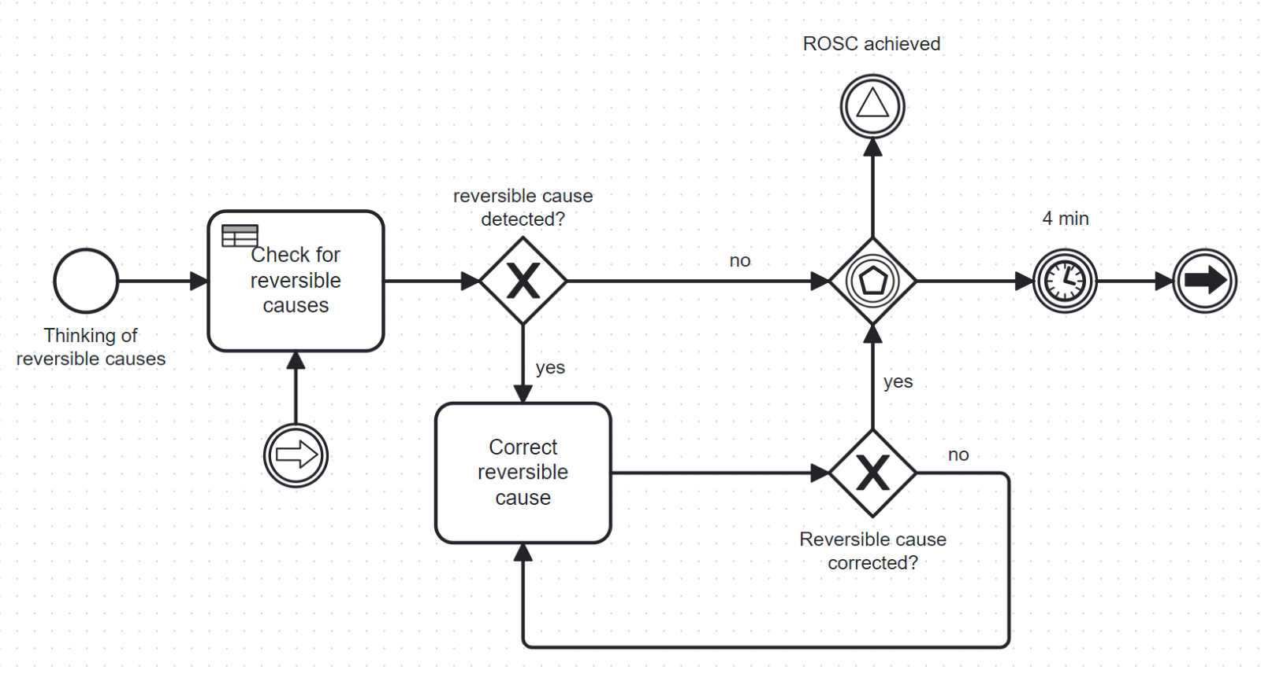
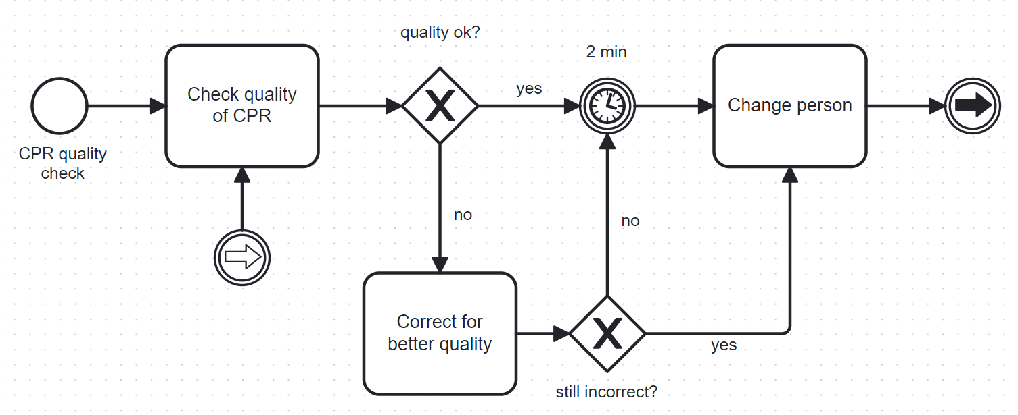
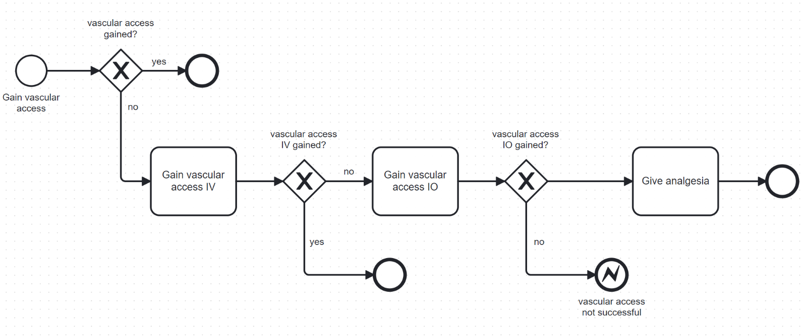
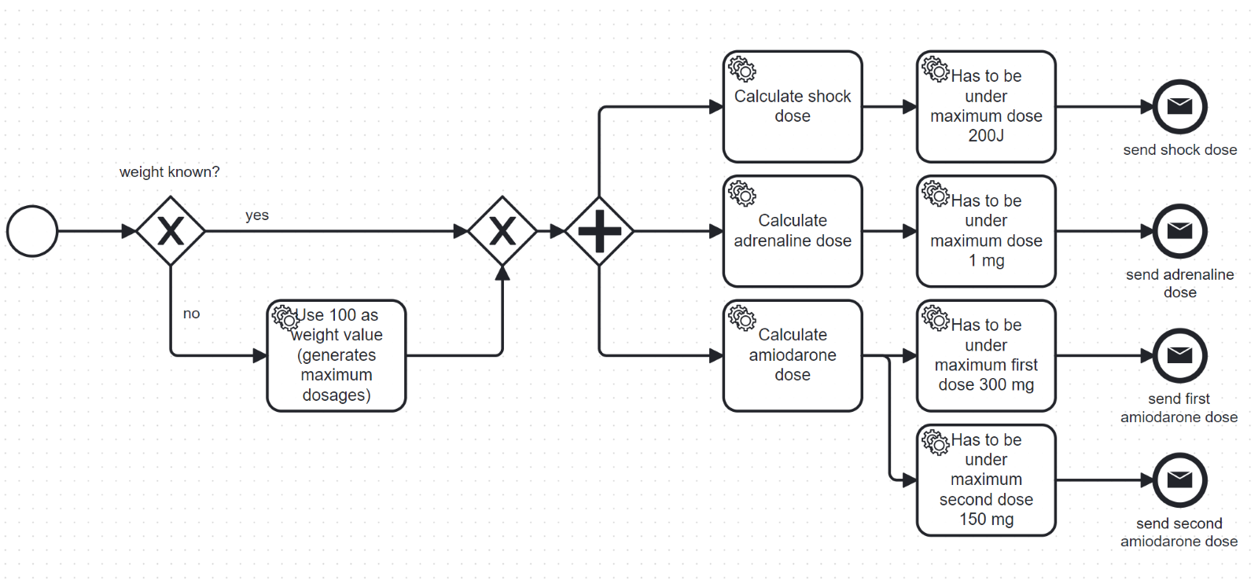
Detailed Workflow
Correct reversible causes
Check CPR quality
Gain vascular access
Calculate dosages with given weight

Slide 12
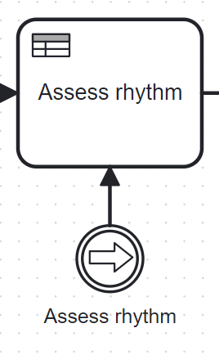
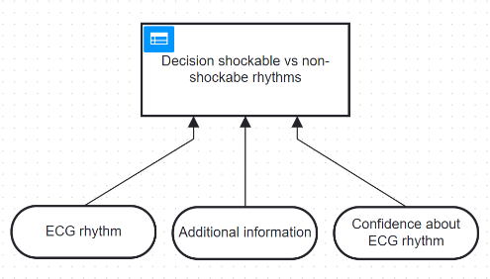
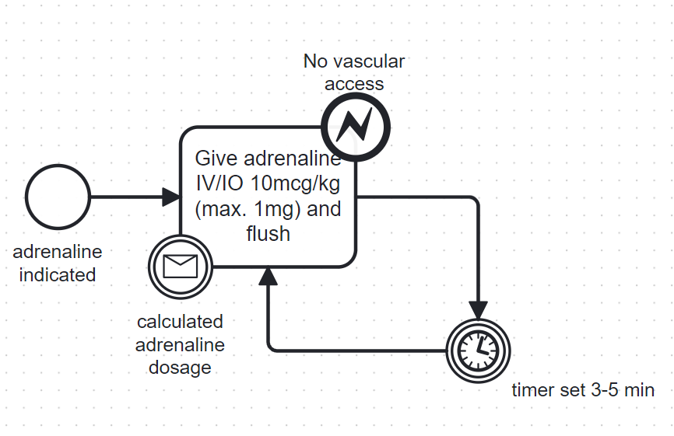
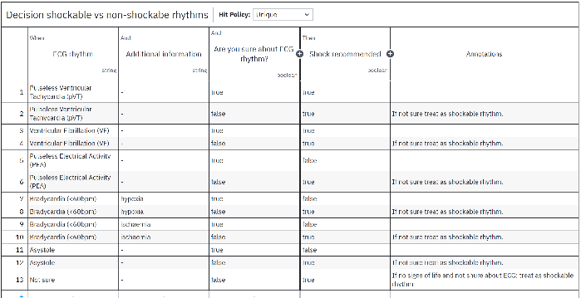
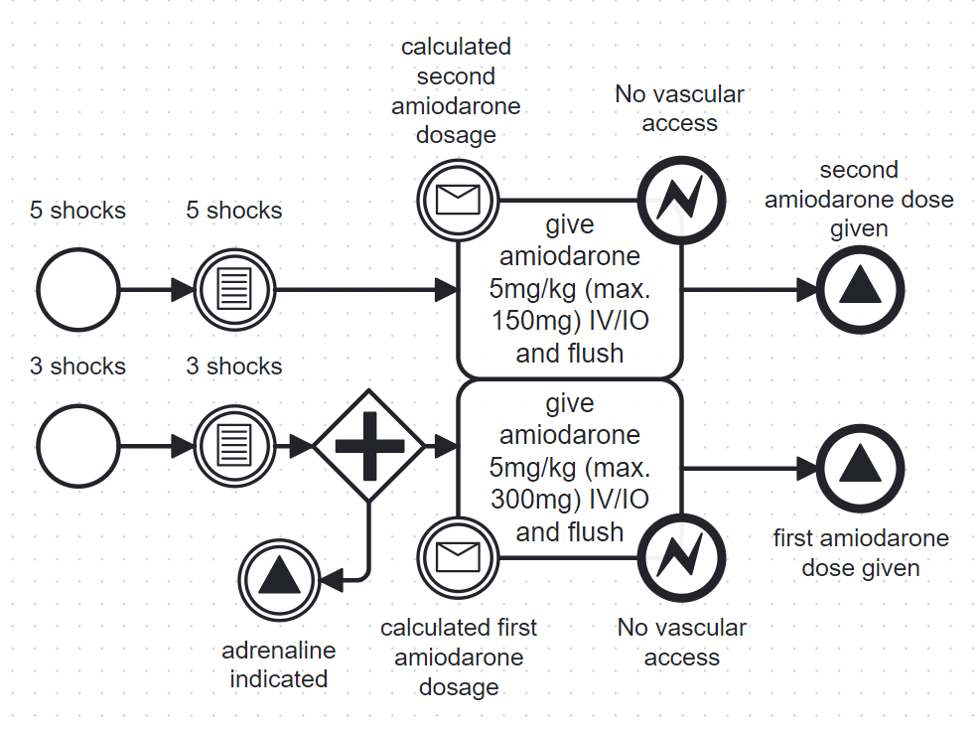
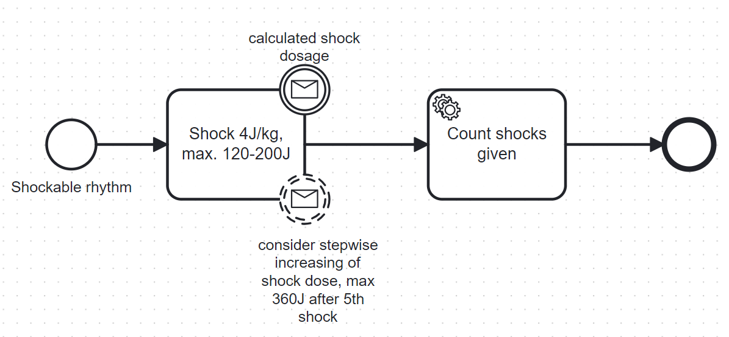
Detailed Workflow
Assess rhythm
Give adrenaline
Evaluate and give right amiodarone dosage
Give shock

Slide 13
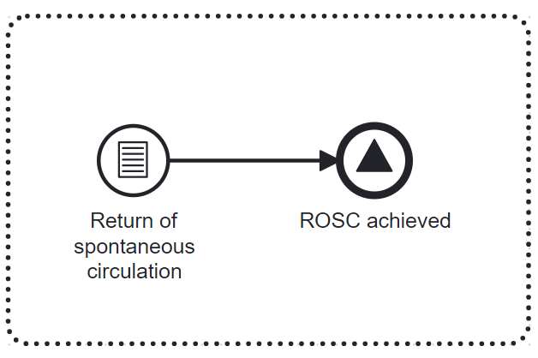
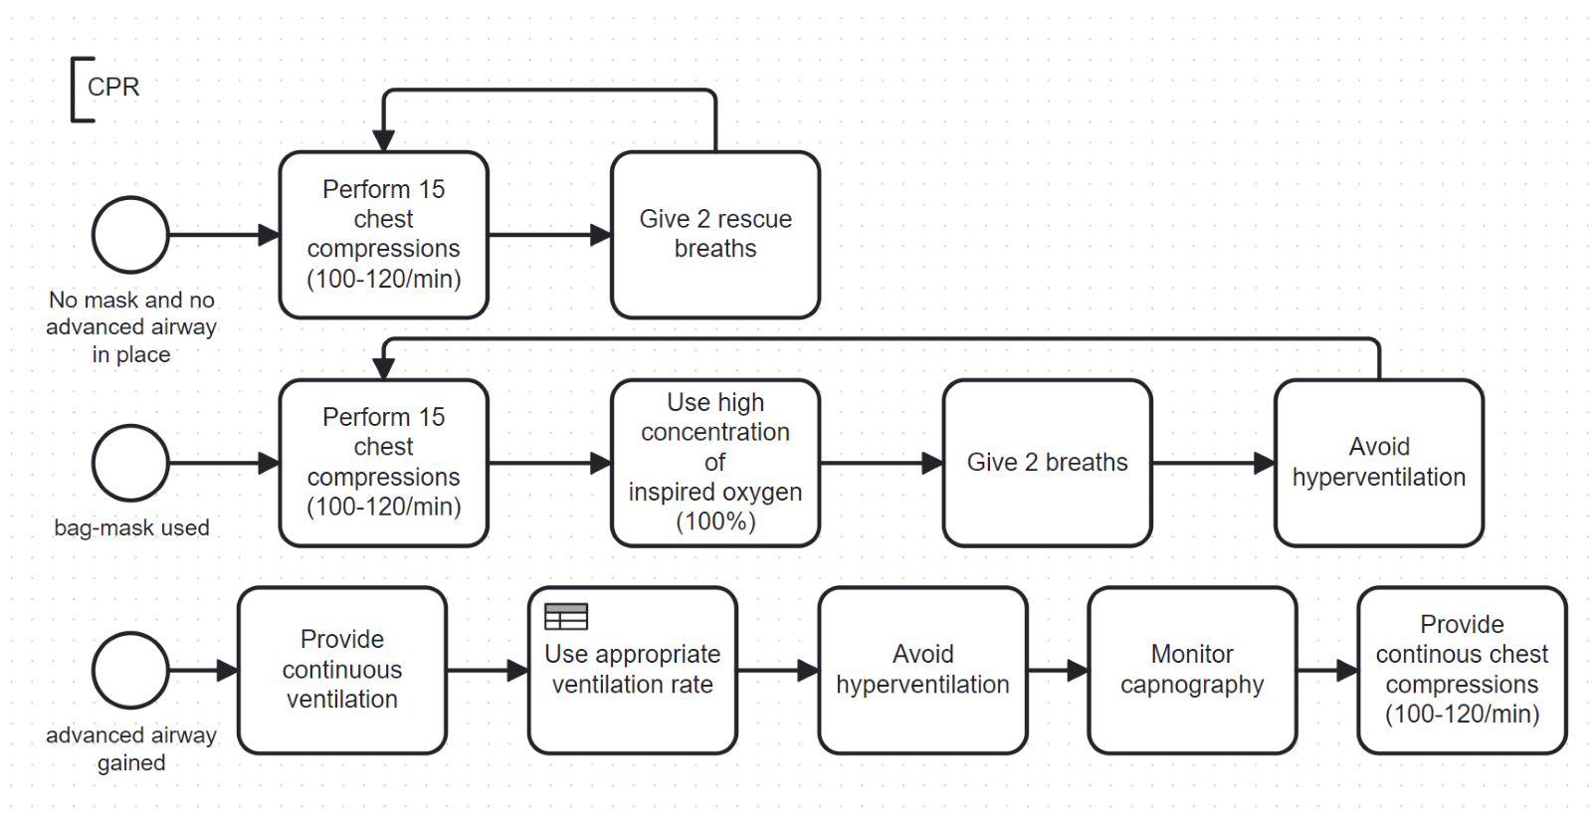
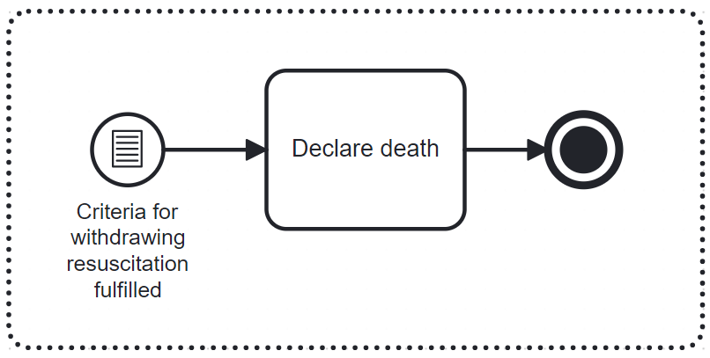
Detailed Workflow
Return of spontaneous circulation
Perform CPR
Criteria for withdrawing resuscitation fulfilled

Slide 14

Challenges in the translation of L1 and L2
Interdependent Directives
Guidelines contain various interdependent sections.
Identification of relevant sections.
Present important sections at the appropriate time.
Must account for legal differences across countries.
Team Process with Parallel Elements
Complex team process involving parallel activities.
Determination and breakdown of subprocesses in BPMN coding.
Extensive and challenging due to repetitive cycles and quantity-dependent sub-paths.
Regular Reviews and Alert Fatigue
Importance of regular reviews of certain subprocesses is indicated.
Balancing reassessment necessity with sufficient intervals to avoid alert fatigue.
Requires careful graphical consideration and processing in future representations.

Slide 15

Machine Readable: Layer 3
ODK XLSForm is a structured template used to design forms for data collection using an Open Data Kit (ODK) or similar platforms.
We tailored the form for pediatric life support and included various sections and data fields to capture essential information during the clinical decision-making processes
Translation from Layer 2 to Layer 3,
Documentation: https://getodk.org/ ; https://xlsform.org/en/

Slide 16
XLSForm: Sheets
Survey Sheet: The primary sheet where the questions and data entry fields are defined.
Choices Sheet: This sheet contains predefined answer choices for multiple-choice questions in the survey sheet.
Settings Sheet: This optional sheet can be used to set form metadata such as form title, version, and language settings.
Documentation: https://getodk.org/ ; https://xlsform.org/en/
Notes:
We tailored the form for pediatric life support and included various sections and data fields to capture essential information during the clinical decision-making processes

Slide 17
Key Sections and Fields
Identification Section | Patient Details: Captures the patient's unique identifier, first name, last name, date of birth, age, weight, address, and emergency contact information.
Initial Assessment | Cardiac Arrest Recognition: Determines if cardiac arrest has been recognized and the type of cardiac rhythm.
Advanced Life Support | Interventions: Records details about ALS interventions such as defibrillation, drug administration, and CPR quality.
Settings Sheet | Form Title: Sets the title of the form. Form ID: A unique identifier for the form versioning and tracking.
Dynamic Features | Relevance Conditions: Questions can appear or be hidden based on previous answers to streamline the data entry process and ensure only relevant information is collected. Constraints and Validations: Ensures data quality by enforcing rules on user inputs

Slide 18

Executable: Layer 4
Deployment Platform: Successfully deployed on KoboToolbox, accessible at https://ee-eu.kobotoolbox.org/x/DpSC1aXV
Real-Time Access: Forms accessible on tablets, smartphones, and computers, both online and offline
Enhanced Functionality: Features include data synchronization, secure storage, real-time analysis, and integration with medical devices
Data Security: Complies with GDPR; HIPAA-compliant private instances available

Slide 19
Testing, implementation, monitoring and evaluation
Quality Assurance Testing:
Risk-based approach: prioritize patient safety, performance, data integrity
Comprehensive functional and performance tests
Translation testing: L2, L3, L4 levels
Automation and CI/CD pipelines for continuous testing
Implementation:
Cloud-based platform, web and mobile access
Seamless EHR integration via standard APIs
Extensive user training and support
Regular updates, strong security, GDPR/HIPAA compliance
Monitoring and Evaluation:
Smooth initial rollout, user adoption, system stability
Continuous optimization and enhancement
Long-term impact assessment on outcomes and satisfaction
Data analytics, user surveys, and clinical audits
Expected Impact:
Improved decision-making and patient outcomes
Streamlined workflows, reduced cognitive load
Enhanced consistency and support during emergencies
Challenges: adaptation and maintaining clinical judgment

Slide 20
Individual Contributions
Sebastian Fernandez:
Main focus on creating L3 & L4
Magdalena Hardegger:
Main focus on L1 to L2 translation, BPMN, Decision table creation, personas
Albertine Karsies:
Main focus on Documentation sections 2.3, 2.7, 2.8, 3, 4, 5
Prerna Duhan:
Main focus on Presentation curation

Slide 21

Thank You
Dr. Fenella Beynon; Prof. Dr. Uri Nahum
Presented By: Sebastian Fernandez, Magdalena Hardegger, Albertine Karsies & Prerna Duhan
Date: 8.07.2024

